Slide 1
Addressing Common Errors in Python

Slide 2
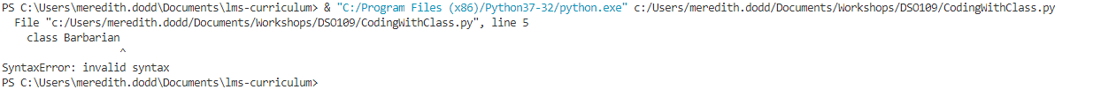
SyntaxError
Missing a colon at the end of an if, class, def, etc.
Use = instead of ==
Using a Python keyword as a variable name
Forgetting parentheses
EOL while scanning string literal
Missing a quotation mark

Slide 3
IndentationError
Must indent after colon

Slide 4
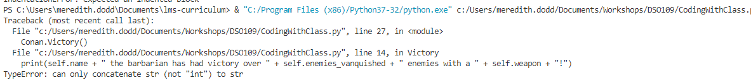
TypeError
Have the wrong data type
Trying to do something with the data the type won’t allow
Ex. Doing math with strings
Using a function without the right number of arguments
Don’t forget self!

Slide 5
IndexError
Trying to reference an index that doesn’t exist in your list or dictionary

Slide 6
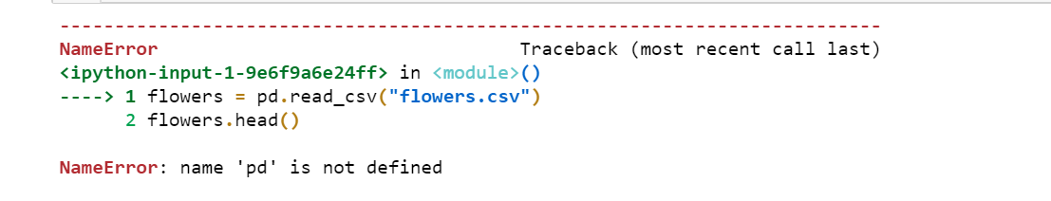
NameError
When you’ve forgotten to import a package
When you’ve missed typed a variable or function name
When the variable or function doesn’t exist

Slide 7
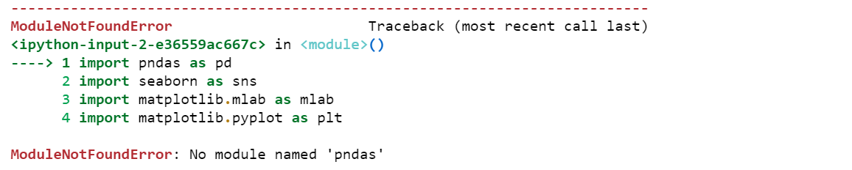
ModuleNotFoundError
You’re trying to import a package that doesn’t exist
For example, spelling issues!

Slide 8

FileNotFoundError
Can’t bring in your data
Check the path
Check the spelling of your file
Check the data type

Slide 9

KeyError
Can’t find the column
Check spelling and that it exists in the data frame

Slide 10
ValueError
Data is the wrong shape (machine learning)
Data has missing values when the function doesn’t allow it

Slide 11
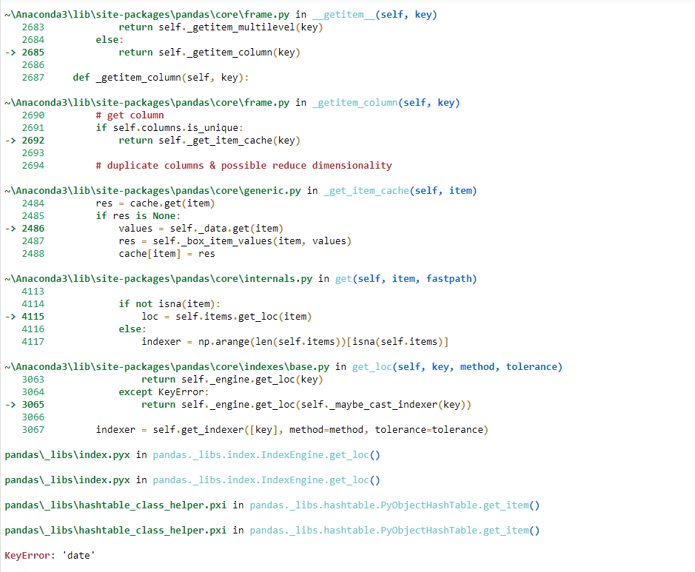
Where to Find Errors
Jupyter Notebook
Visual Studio Code
Look at the very bottom!
Look at the terminal at the bottom!

Slide 12
Errors, Errors, Everywhere!
Fix one to see the next
An error early on might not show right away – so if the line number it specifies looks good, then you may need to look higher up for issues too
Don’t panic! Troubleshooting is part of being a data scientist

